Slide 1
Department of CSE
COURSE NAME: DBMS
COURSE CODE:24AD2103
Topic:
SQL Languages and Create table command
Session - 7

Slide 2




AIM OF THE SESSION
To familiarize students with the basic concept of SQL languages and Create table command in detail.
INSTRUCTIONAL OBJECTIVES
This Session is designed to:
Discuss the types of SQL languages.
Various command under different types of SQL Languages.
Introduction of Create table command with its syntax and examples.
LEARNING OUTCOMES
At the end of this session, you should be able to understand the basic commands of SQL and learn how to write queries with SQL commands.

Slide 3
INTRODUCTION
Structured Query Language(SQL) as we all know is the database language by the use of which we can perform certain operations on the existing database and also we can use this language to create a new database. Following are the four different types of languages or commands which are widely used in SQL queries:
DDL (Data Definition Language)
DML (Data Manipulation Language)
TCL (Transaction Control Language)
DCL (Data Control Language)

Slide 4
DATA DEFINITION LANGUAGE
Data Definition Language
Data Definition Language actually consists of the SQL commands that can be used to define the database structure or schema.
It simply deals with descriptions of the database schema and is used to create and modify the structure of database objects in the database.
DDL is a set of SQL commands used to create, modify, and delete database structures but not data.
These commands are normally not used by a general user, who should be accessing the database via an application.

Slide 5
DATA DEFINITION LANGUAGE (Cont..)
List of DDL commands
CREATE: This command is used to create the new database or its objects.
ALTER: This is used to alter the structure of the database.
DROP: This command is used to delete objects from the database.
TRUNCATE: This is used to remove all records from a table, including all spaces allocated for the records are removed.
RENAME: This is used to rename an object existing in the database.

Slide 6
DATA DEFINITION LANGUAGE (Cont..)
CREATE TABLE command: This DDL command allows us to create the new table.
CREATE TABLE [IF NOT EXISTS] <table_name> ( <column1> <data_type(length)> [column_contraint], <column2> <data_type(length)> [column_contraint], ... <columnN> <data_type(length)> [column_contraint], [table_constraints] );
In the above syntax,
After CREATE TABLE we can specify optional IF NOT EXISTS clause, which will create a table only if it does not exist. If a table already exists, Postgres will only give a warning instead of an error and skip creating a new table.
The table_name is the unique name of a table which you want to create.
In the bracket, specify the list of column names along with their data types. Specify the optional [column_constraint] such as NOT NULL, Check, Unique, Primary Key, Foreign Key etc.

Slide 7
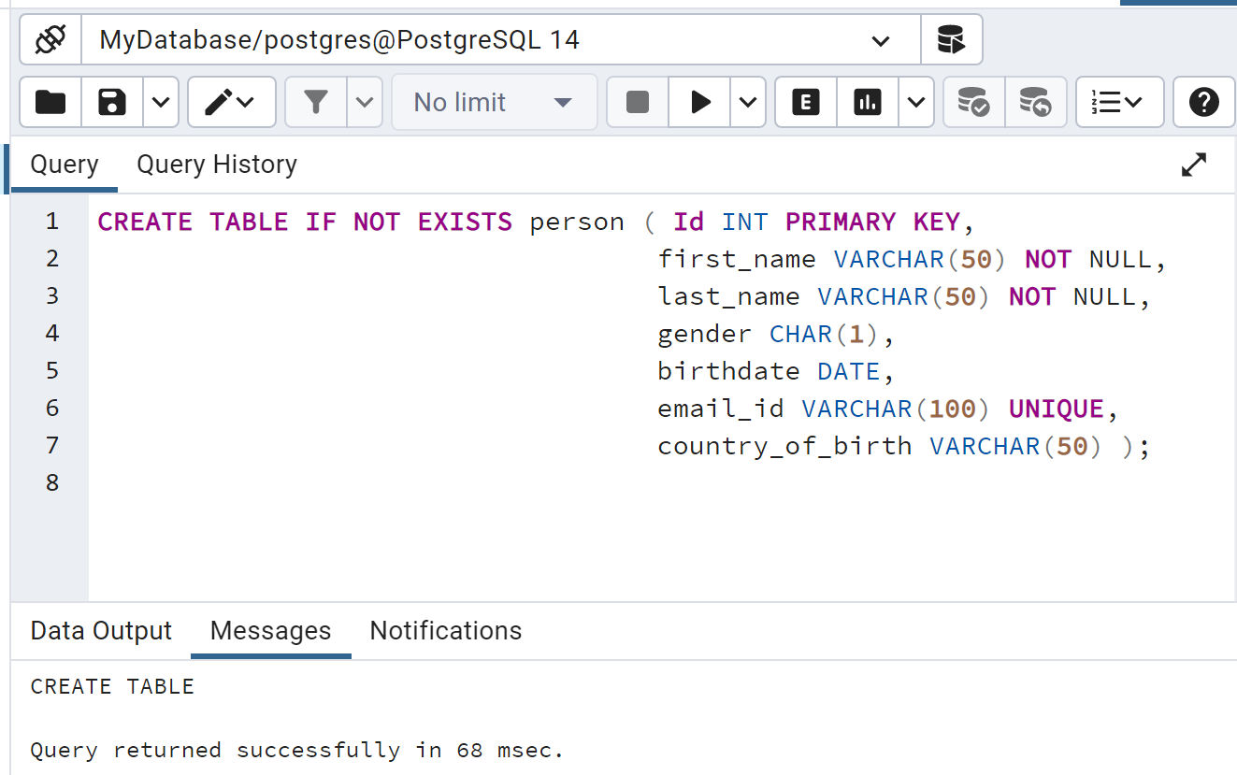
DATA DEFINITION LANGUAGE (Cont..)
CREATE TABLE IF NOT EXISTS person ( Id INT PRIMARY KEY, first_name VARCHAR(50) NOT NULL, last_name VARCHAR(50) NOT NULL, gender CHAR(1), birthdate DATE, email_id VARCHAR(100) UNIQUE, country_of_birth VARCHAR(50) );

Slide 8
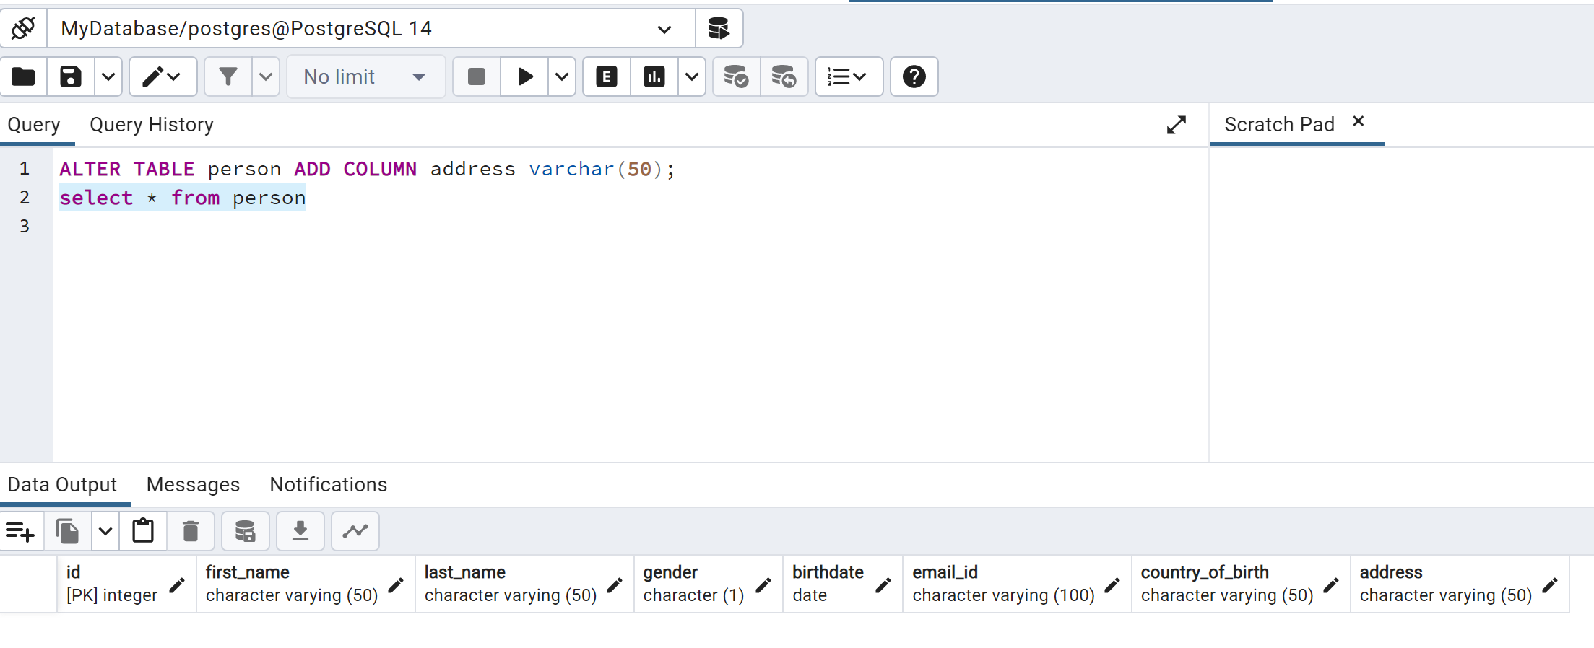
DATA DEFINITION LANGUAGE (Cont..)
2) ALTER TABLE command: This DDL command allows to alter the structure of the database. The commands are:
A) ADD COLUMN: It is used to add a new column in the table. For example, to add a column address of type varchar to an existing table:
ALTER TABLE person ADD COLUMN address varchar(50);

Slide 9
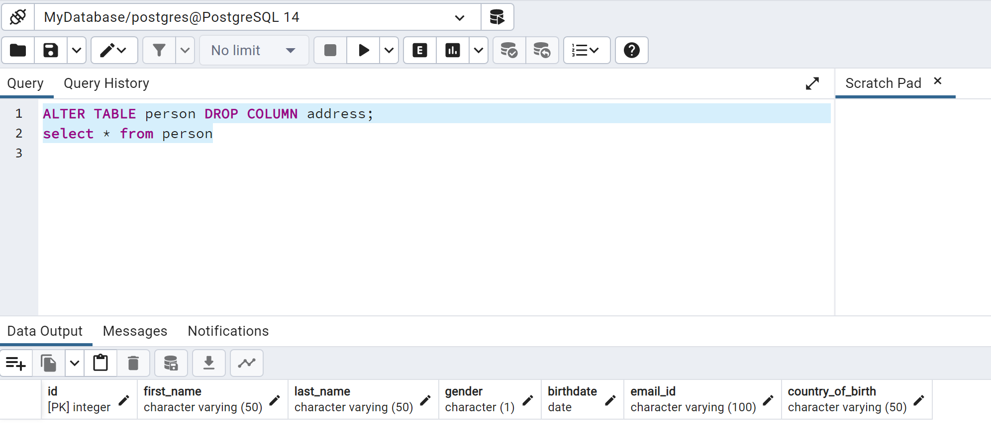
DATA DEFINITION LANGUAGE (Cont..)
B) DROP COLUMN: It is used to drop an existing column from the table.
ALTER TABLE person DROP COLUMN address;

Slide 10
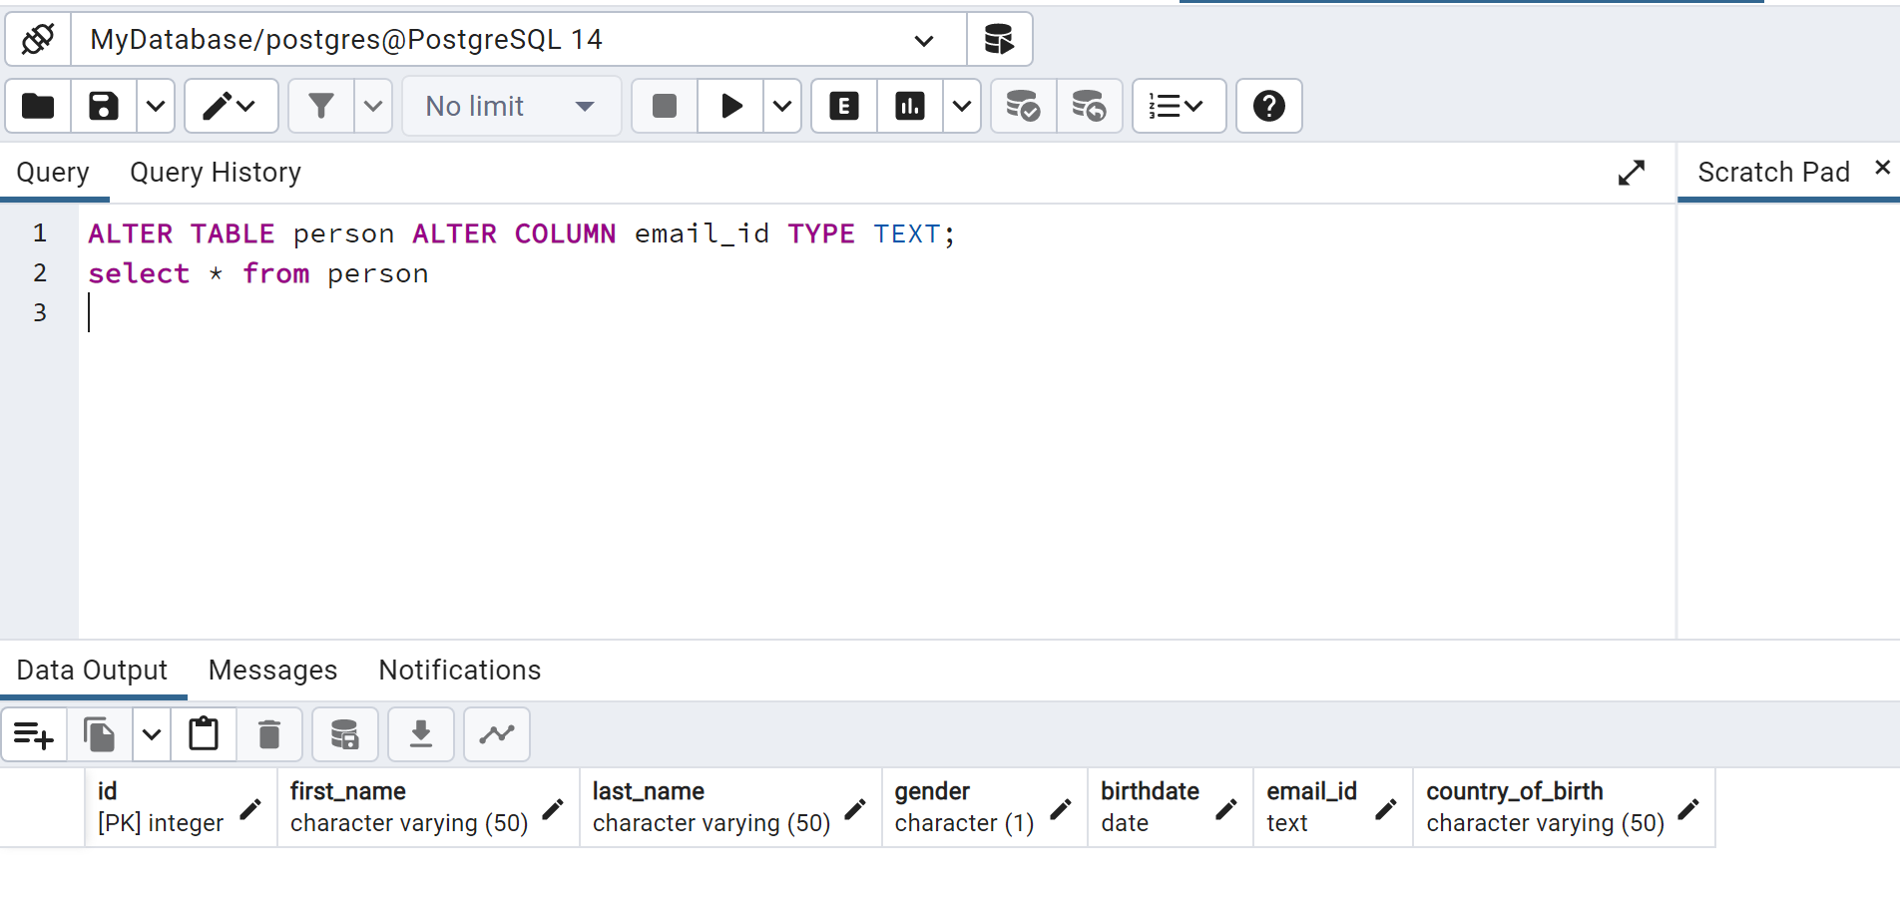
DATA DEFINITION LANGUAGE (Cont..)
C) ALTER COLUMN: It is used to alter the existing column. To change the datatype of email from VARCHAR to TEXT.
ALTER TABLE person ALTER COLUMN email_id TYPE TEXT;

Slide 11
DATA DEFINITION LANGUAGE (Cont..)
To add a NOT NULL constraint to a column:
ALTER TABLE person ALTER COLUMN gender SET NOT NULL;
To remove a NOT NULL constraint from a column:
ALTER TABLE person ALTER COLUMN gender DROP NOT NULL;
To add a PRIMARY KEY constraint to a table:
ALTER TABLE person ADD PRIMARY KEY (id);

Slide 12
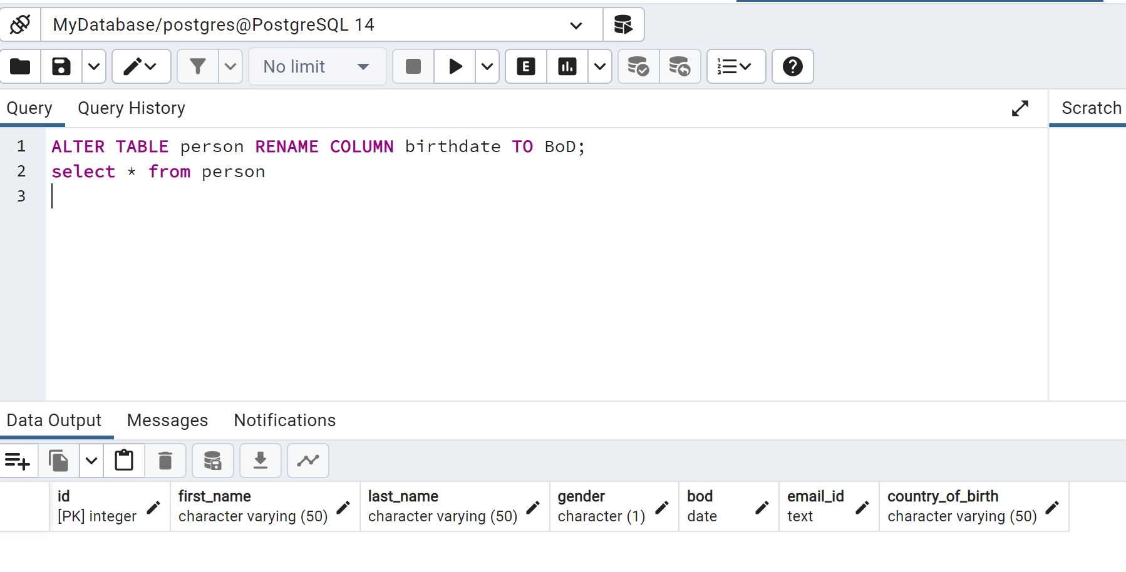
DATA DEFINITION LANGUAGE (Cont..)
D) RENAME COLUMN: It is used to change the name of a column.
ALTER TABLE person RENAME COLUMN birthdate TO BoD;

Slide 13
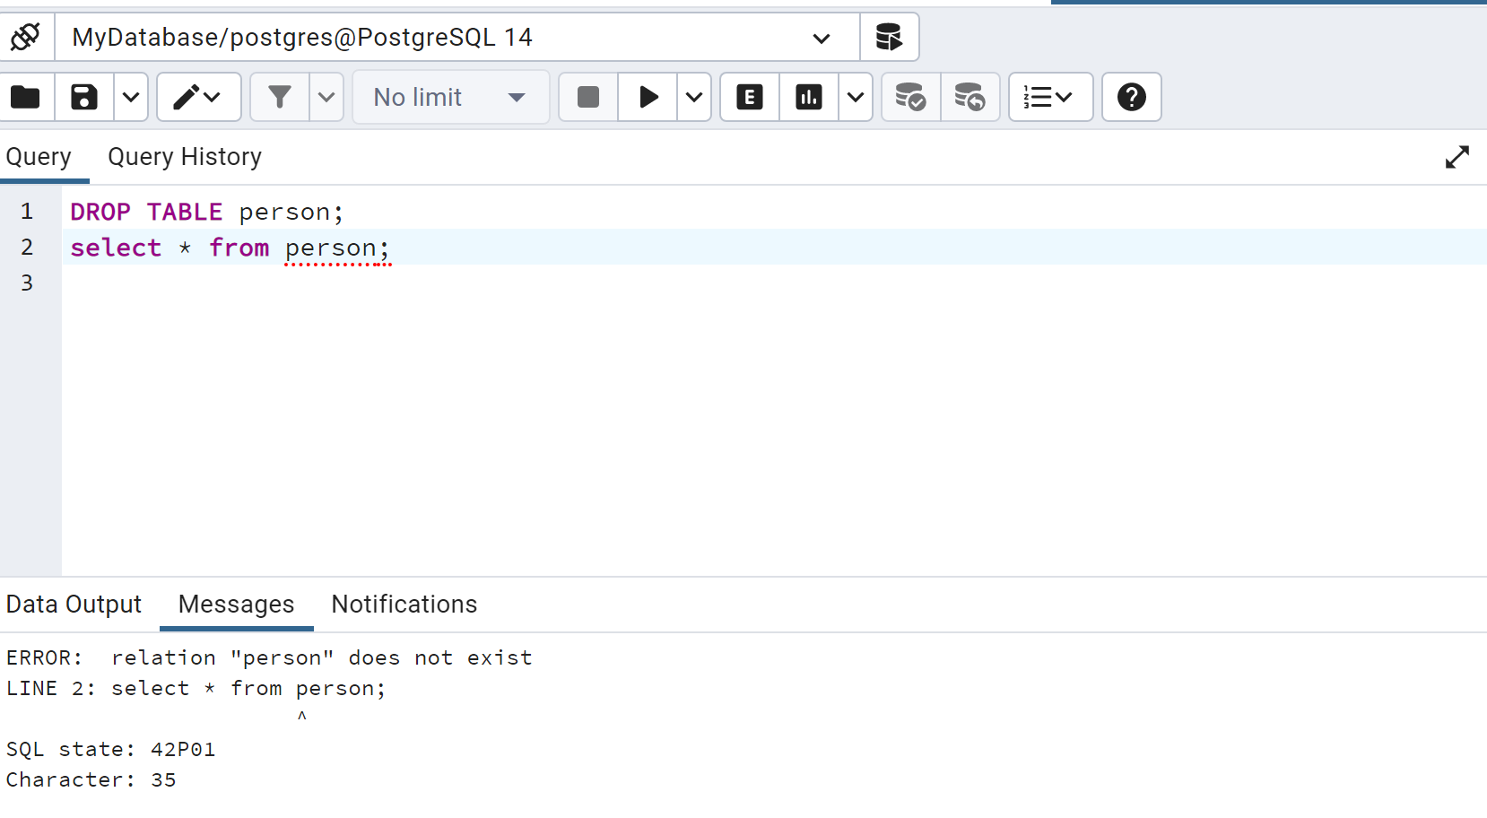
DATA DEFINITION LANGUAGE (Cont..)
3) DROP command: This DDL command allows us to delete the database objects. With the help of the “DROP” command we can drop (delete) the whole structure in one go.
DROP TABLE person;

Slide 14
DATA DEFINITION LANGUAGE (Cont..)
4) TRUNCATE command: It is used to delete all the data from the table. With the help of the “TRUNCATE” command, we can’t delete the single row as here WHERE clause is not used.
Syntax of TRUNCATE TABLE command: TRUNCATE TABLE table_name;
5) ALTER TABLE RENAME command: This DDL command allows the users to change the name of the existing table. For example, To rename from person to employee, use the following ALTER TABLE statement:
ALTER TABLE person RENAME TO employee;

Slide 15
DATA MANIPULATION LANGUAGE
DML Commands in SQL
DML is an abbreviation of Data Manipulation Language.
The DML commands in Structured Query Language change the data present in the SQL database. We can easily access, store, modify, update and delete the existing records from the database using DML commands.
Following are the four main DML commands in SQL:
SELECT Command
INSERT Command
UPDATE Command
DELETE Command

Slide 16
DATA MANIPULATION LANGUAGE (Cont..)
1) SELECT command: This DML command allows us to access the stored records from the tables. We can also use the condition in the SELECT command for accessing the particular rows.
Syntax of SELECT DML command
SELECT column_Name_1, column_Name_2, ….., column_Name_N FROM Name_of_table;
Here, column_Name_1, column_Name_2, ….., column_Name_N are the names of those columns whose data we want to retrieve from the table.
If we want to retrieve all the data from all the columns of the table, we have to use the following SELECT command:
SELECT * FROM table_name;

Slide 17
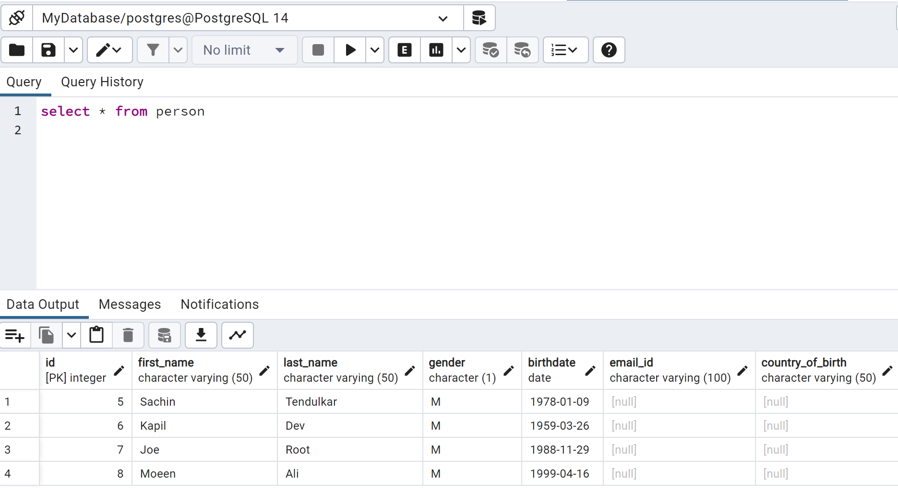
DATA MANIPULATION LANGUAGE (Cont..)
Examples of SELECT Command
Example 1: This example shows all the values of every column from the table.
SELECT * FROM person;

Slide 18
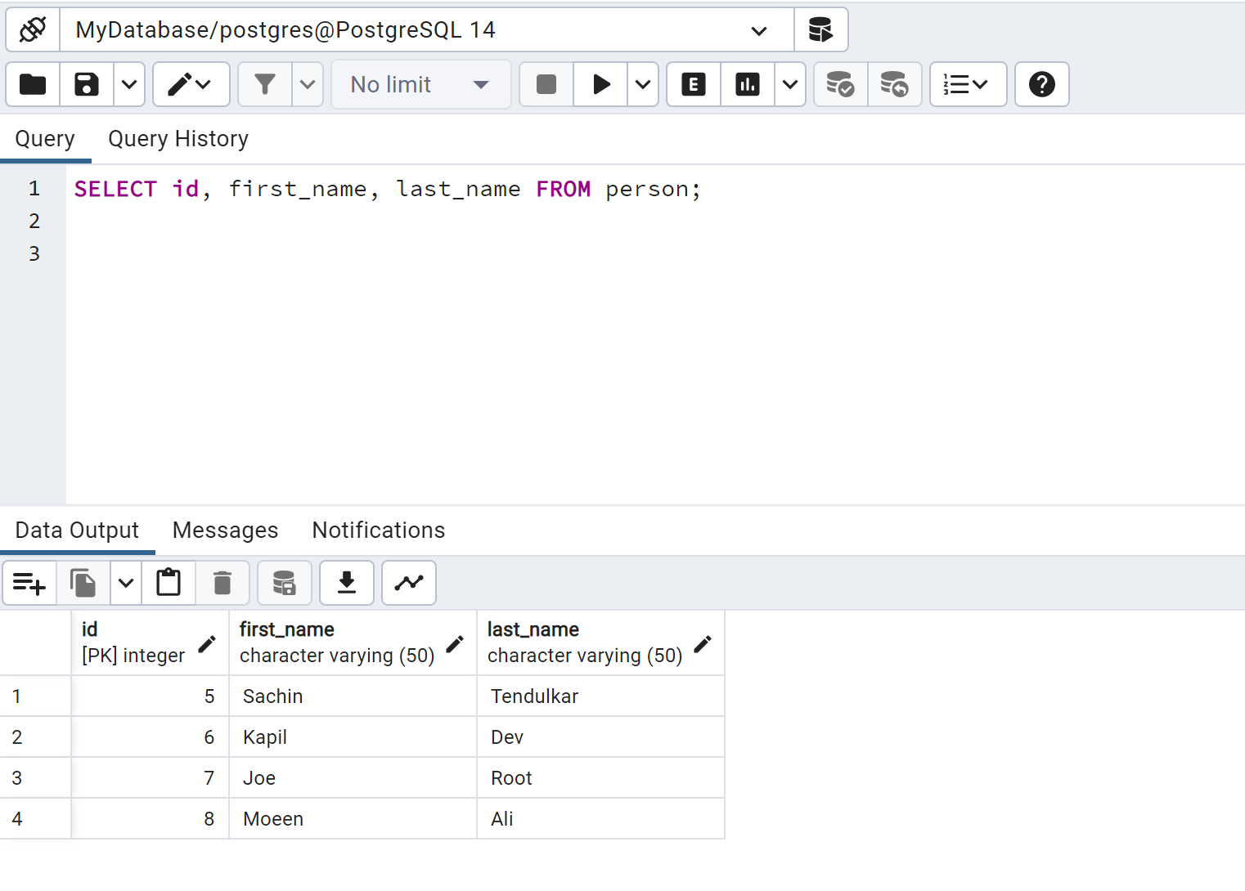
DATA MANIPULATION LANGUAGE (Cont..)
Example 2: The following SELECT statement retrieves the data from multiple columns of the employee table.
SELECT id, first_name, last_name FROM person;

Slide 19
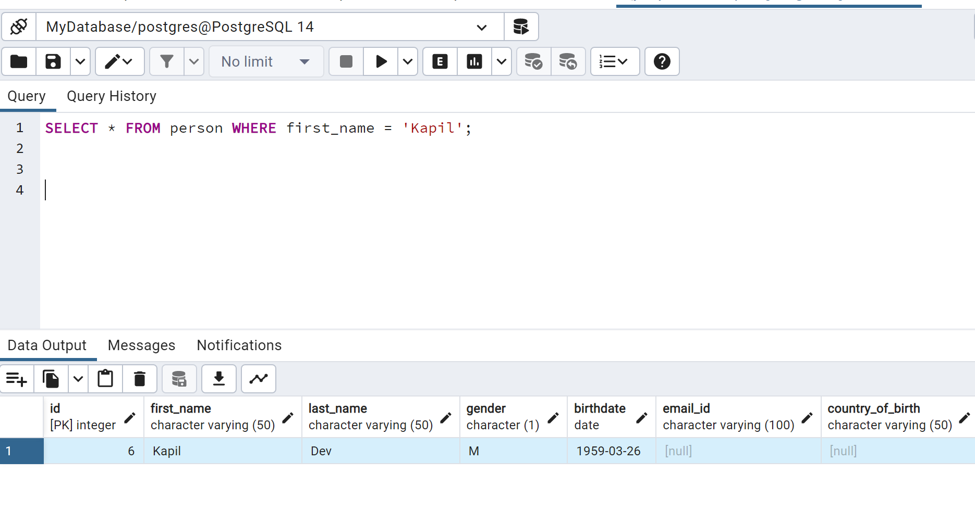
DATA MANIPULATION LANGUAGE (Cont..)
Example 3: This example describes how to use the WHERE clause with the SELECT command.
If we want to access all the records of those person whose first_name is Kapil.
SELECT * FROM person WHERE first_name = ‘Kapil';

Slide 20
DATA MANIPULATION LANGUAGE (Cont..)
2) INSERT command: INSERT is another most important data manipulation command in Structured Query Language, which allows users to insert data in database tables.
Use the INSERT INTO clause with the table-name where you want to insert the data. If you want to insert data to all columns of a table, then specifying the list of columns is optional.
If you want to insert data to some columns, then provide a list of comma-separated values after the VALUES clause.
The RETURNING clause is optional which will return a list of all inserted values or the value of the specified column.
INSERT INTO <table-name> (<column1>, <column2>,...) VALUES (<value1>, <value2>,...) RETURNING *;

Slide 21
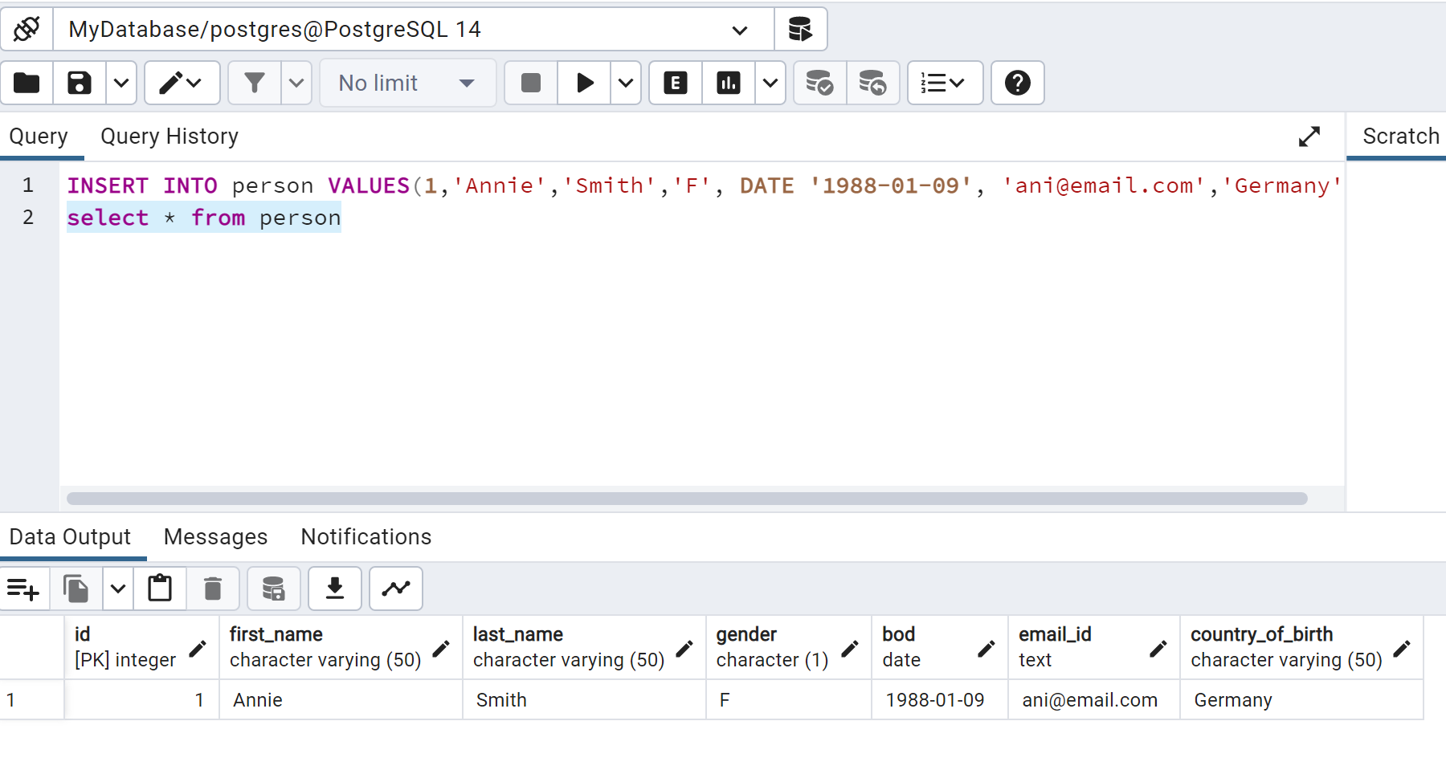
DATA MANIPULATION LANGUAGE (Cont..)
Now, the following INSERT statement will insert a single row in the person table.
INSERT INTO person VALUES(1,'Annie','Smith','F', DATE '1988-01-09', 'ani@email.com’,’Germany’);

Slide 22
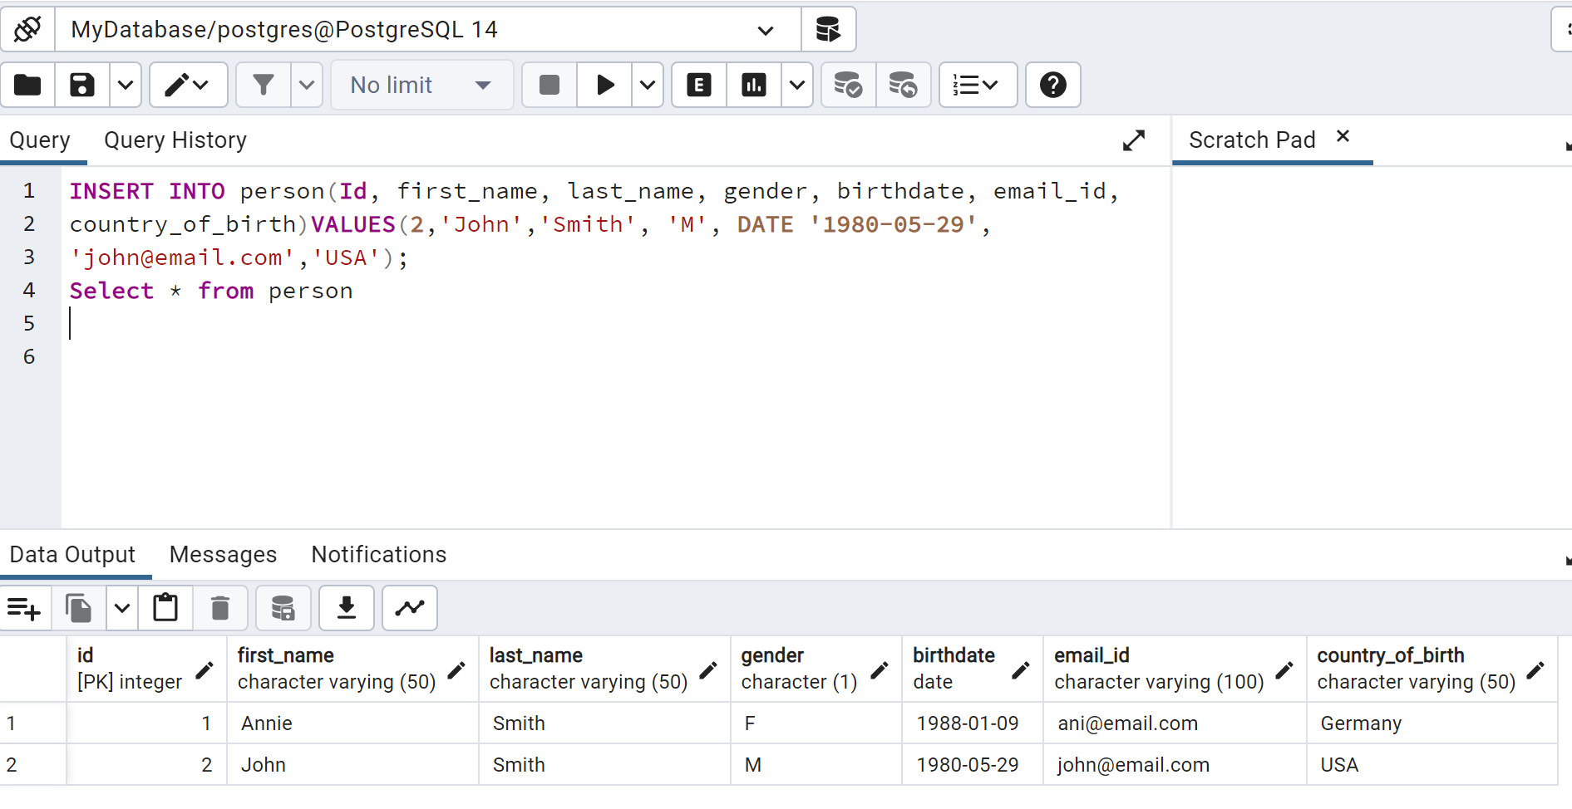
DATA MANIPULATION LANGUAGE (Cont..)
It is the best practice to specify columns names with the INSERT statement to insert data into correct columns and make it more maintainable. For example:
INSERT INTO person(Id, first_name, last_name, gender, birthdate, email_id, country_of_birth) VALUES(2,John','Smith',’M',’1980-05-29', ‘john@email.com’,’USA’);

Slide 23
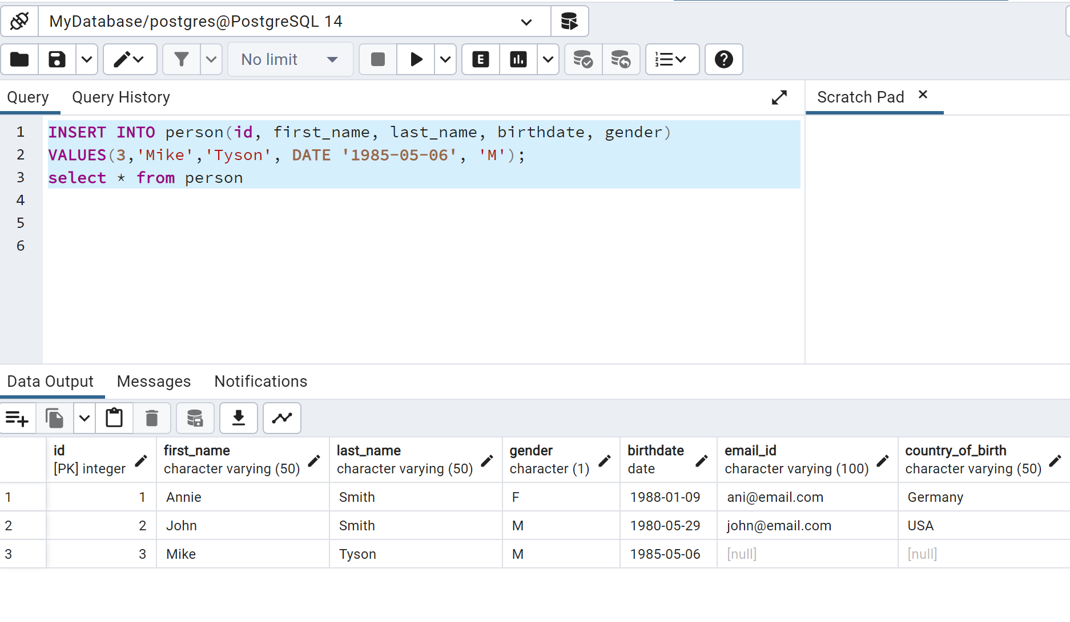
DATA MANIPULATION LANGUAGE (Cont..)
We can change the order of the columns or remove columns from the INSERT statement as per your need.
INSERT INTO person (id, first_name, last_name, birthdate, gender) VALUES (3, 'Mike’, 'Tyson', DATE '1985-05-06’, 'M');

Slide 24
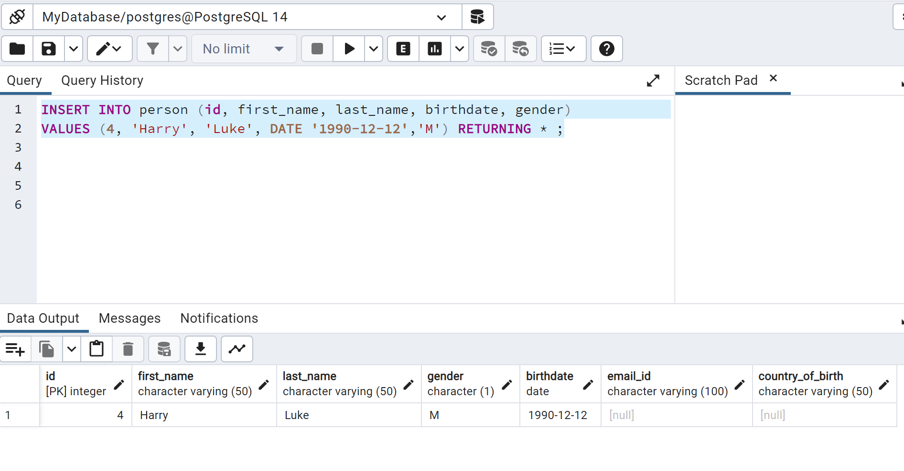
DATA MANIPULATION LANGUAGE (Cont..)
The RETURNING clause returns inserted column values. The RETURNING * returns all the inserted values or RETURNING column-name returns the specified column value.
INSERT INTO person (id, first_name, last_name, birthdate, gender) VALUES (4, ‘Harry’, ‘Luke', DATE ‘1990-12-12’, 'M’) RETURNING * ;

Slide 25
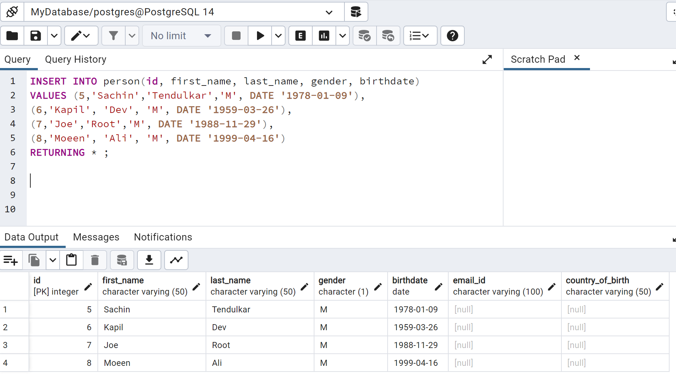
DATA MANIPULATION LANGUAGE (Cont..)
The INSERT statement can also add multiple rows to a table in a single query by specifying multiple VALUES clauses.
INSERT INTO person(id, first_name, last_name, gender, birthdate) VALUES (5,'Sachin','Tendulkar','M', DATE '1978-01-09'), (6,'Kapil', 'Dev', 'M', DATE '1959-03-26'), (7,'Joe','Root','M', DATE '1988-11-29'), (8,'Moeen', 'Ali', 'M', DATE '1999-04-16');

Slide 26
DATA MANIPULATION LANGUAGE (Cont..)
3) UPDATE command: This DML command allows the database users to change the existing record or rows in the tables.
UPDATE <table_name> SET <column1> = <value1>, <column2> = <value2>, ... WHERE <condition>
Here, 'UPDATE', 'SET', and 'WHERE' are the SQL keywords, and 'Table_name' is the name of the table whose values we want to update.
For example, the following UPDATE statement will update an email of a person whose id=1.
UPDATE person SET email_id = 'annie.smith@myemail.com' WHERE id = 1;

Slide 27
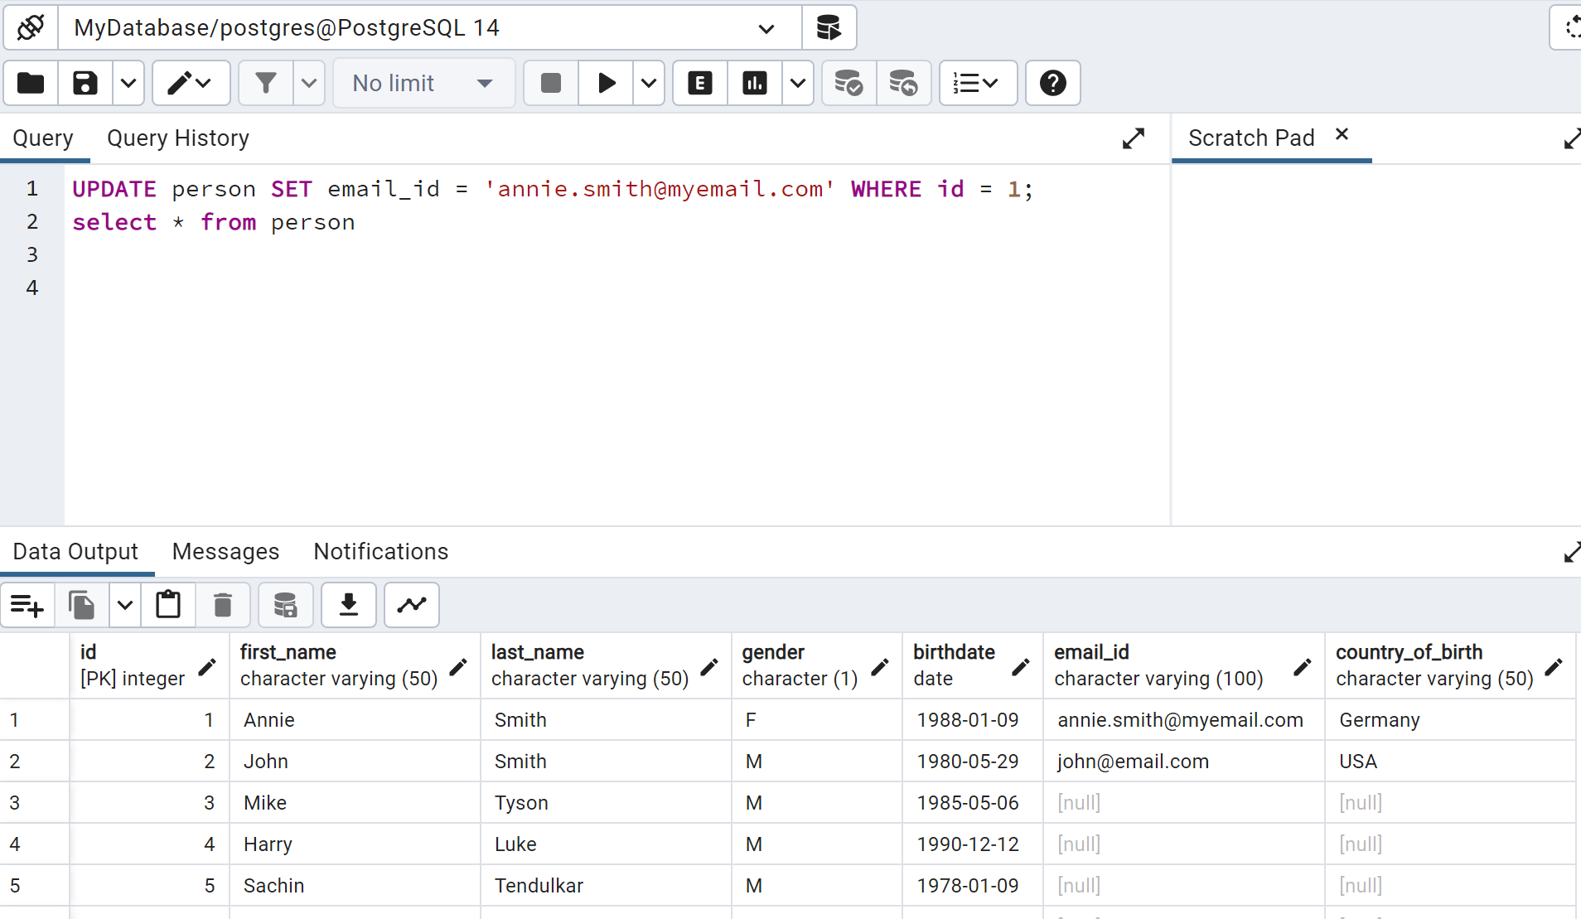
DATA MANIPULATION LANGUAGE (Cont..)
If you don't specify the WHERE clause, then it will update the email column value in all the rows.
UPDATE person SET email_id = 'annie.smith@myemail.com';

Slide 28
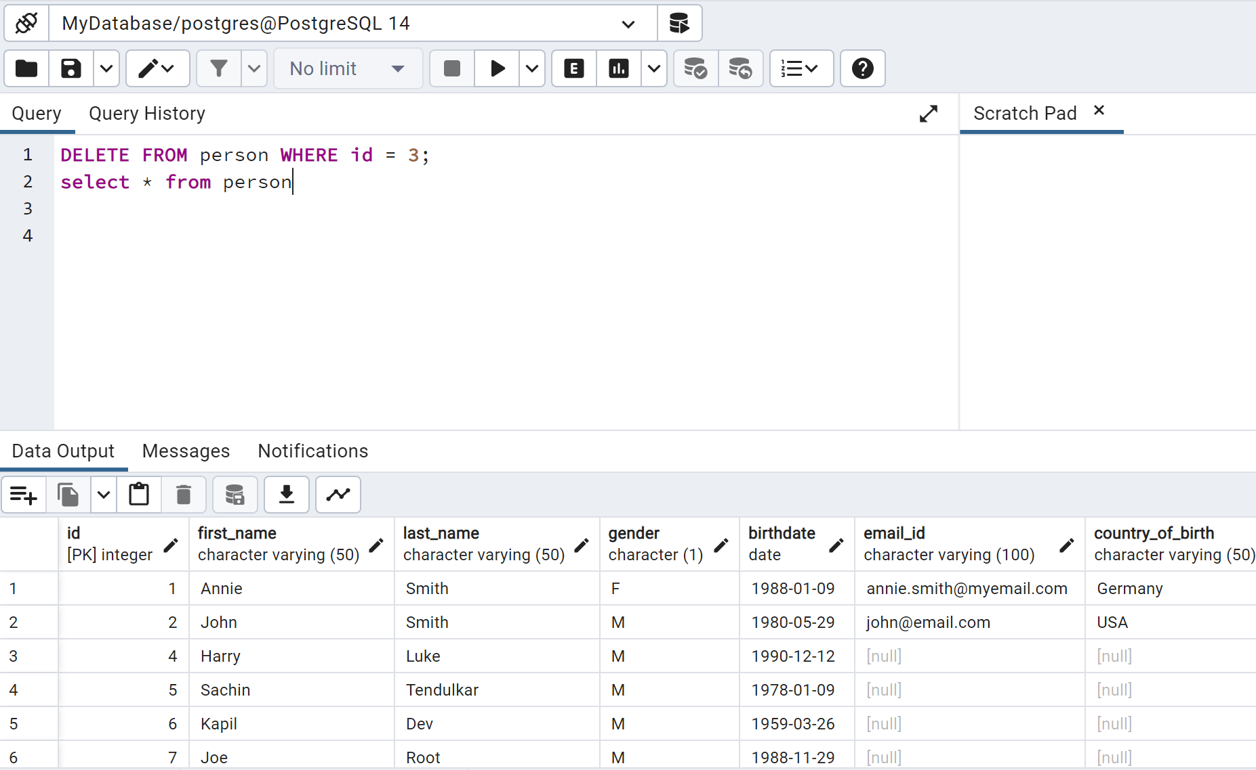
DATA MANIPULATION LANGUAGE (Cont..)
3) DELETE command: DELETE is a DML command which allows SQL users to remove single or multiple existing records from the database tables.
DELETE FROM Table_Name WHERE condition;
let's remove data from the person table whose id is 3.
DELETE FROM person WHERE id = 3;

Slide 29
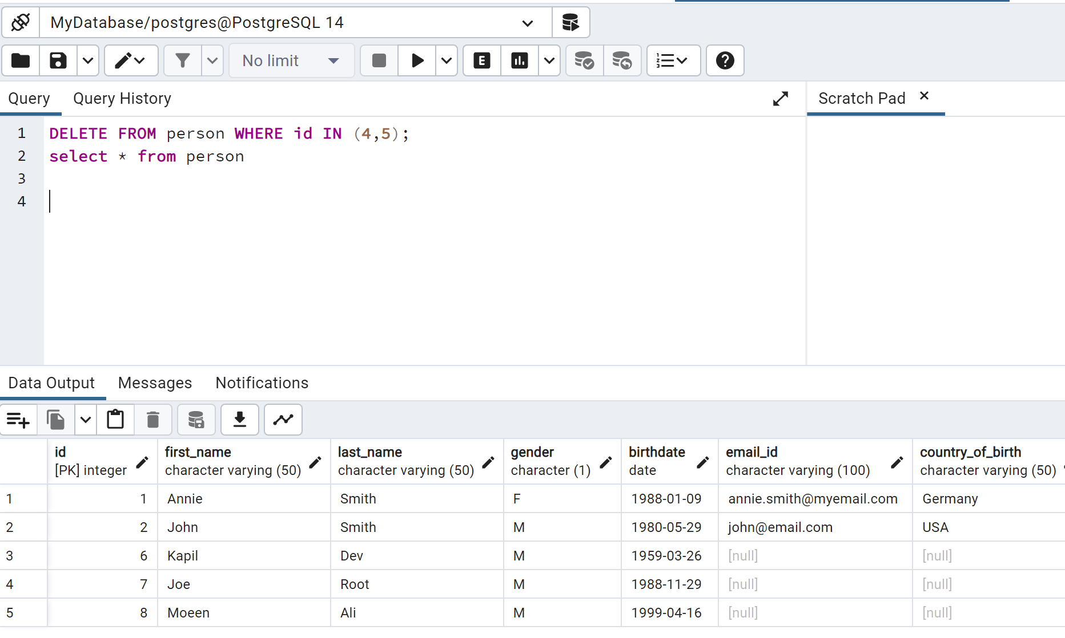
DATA MANIPULATION LANGUAGE (Cont..)
The DELETE statement can remove multiple records from the person table. For example, now we will remove rows where id = 4 and 5.
DELETE FROM person WHERE id IN (4,5);

Slide 30
DATA CONTROL LANGUAGE
3) Data Control Language (DCL)
Data Control Language allows DBA to manage the rights and permissions on the data in the database. Following are the two DCL Languages or commands used in the SQL queries:
Grant DCL Command
Revoke DCL Command
A. Grant: It is used to give user access privileges to a database.
Privileges can be SELECT, INSERT, UPDATE, DELETE, TRUNCATE, REFERENCES, TRIGGER, CREATE, ALL. You can also specify combination of these privileges in a statement.
GRANT privileges ON object TO user;

Slide 31
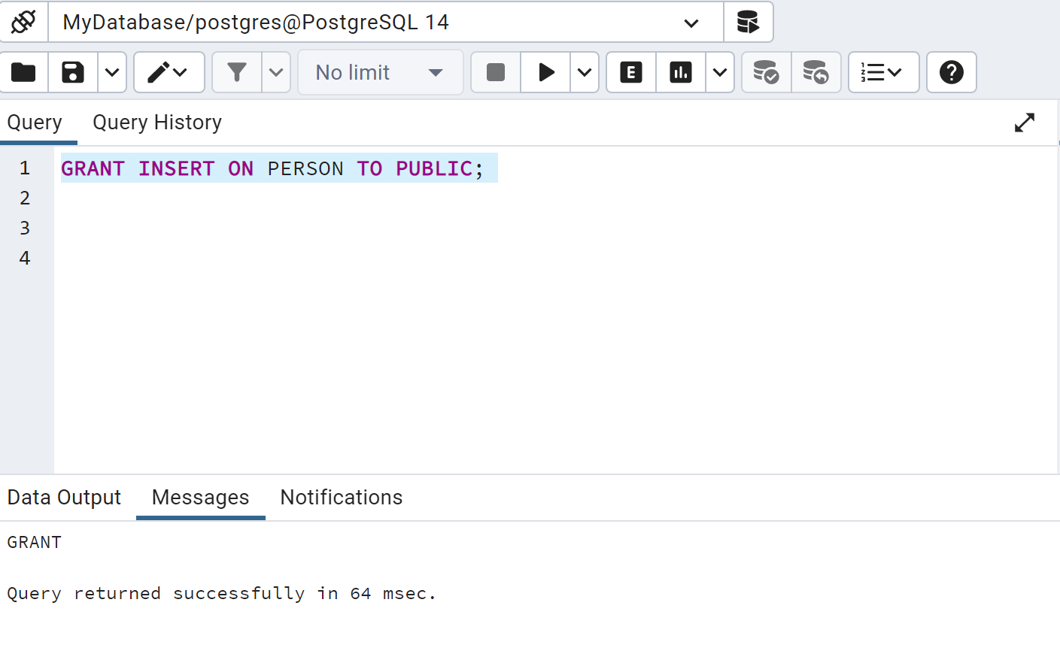
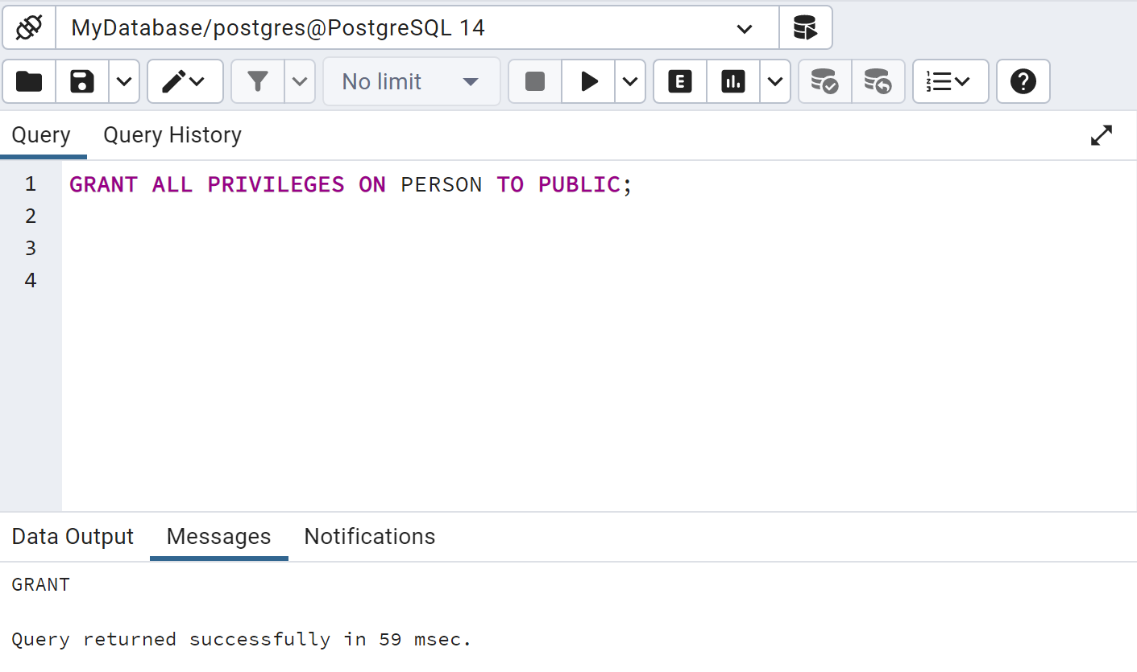
DATA CONTROL LANGUAGE (Cont..)
Grant insert privilege to all users on table person:
GRANT INSERT ON person TO PUBLIC;
Grant all available privileges to all users on table person:
GRANT ALL PRIVILEGES ON person TO PUBLIC;

Slide 32
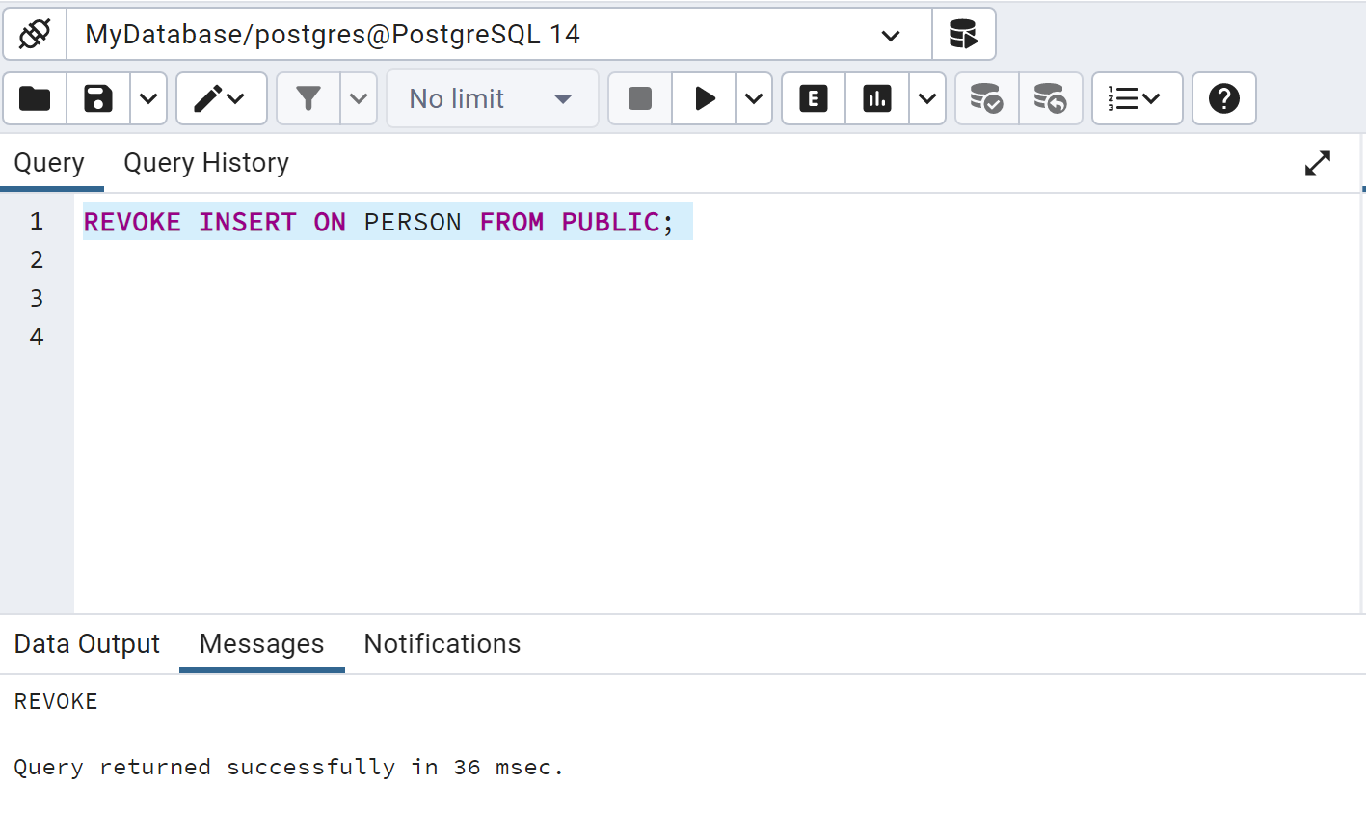
DATA CONTROL LANGUAGE (Cont..)
B. Revoke: This DCL command allows the database administrator to remove all the permissions applied by the GRANT DCL command.
REVOKE PRIVILEGES ON object FROM USER;
For example, to revoke the already granted insert privilege to all users on table person:
REVOKE INSERT ON PERSON FROM PUBLIC;

Slide 33
TRANSACTION CONTROL LANGUAGE
Transaction Control Language (TCL)
TCL commands can only be used with DML commands like INSERT, DELETE and UPDATE only. Following are the two TCL commands:
Commit: This command allows the database users to save the operations in the database.
DELETE FROM Student WHERE AGE = 25;
COMMIT;
B. Rollback: Rollback command allows you to undo transactions that have not
already been saved to the database.
DELETE FROM Student WHERE AGE = 25;
ROLLBACK;

Slide 34
CREATE TABLE COMMAND
This DDL command allows us to create the new table.
CREATE TABLE [IF NOT EXISTS] <table_name> ( <column1> <data_type(length)> [column_contraint], <column2> <data_type(length)> [column_contraint], ... <columnN> <data_type(length)> [column_contraint], [table_constraints] );
CREATE TABLE IF NOT EXISTS person ( Id INT PRIMARY KEY, first_name VARCHAR(50) NOT NULL, last_name VARCHAR(50) NOT NULL, gender CHAR(1), birthdate DATE, email_id VARCHAR(100) UNIQUE, country_of_birth VARCHAR(50) );

Slide 35
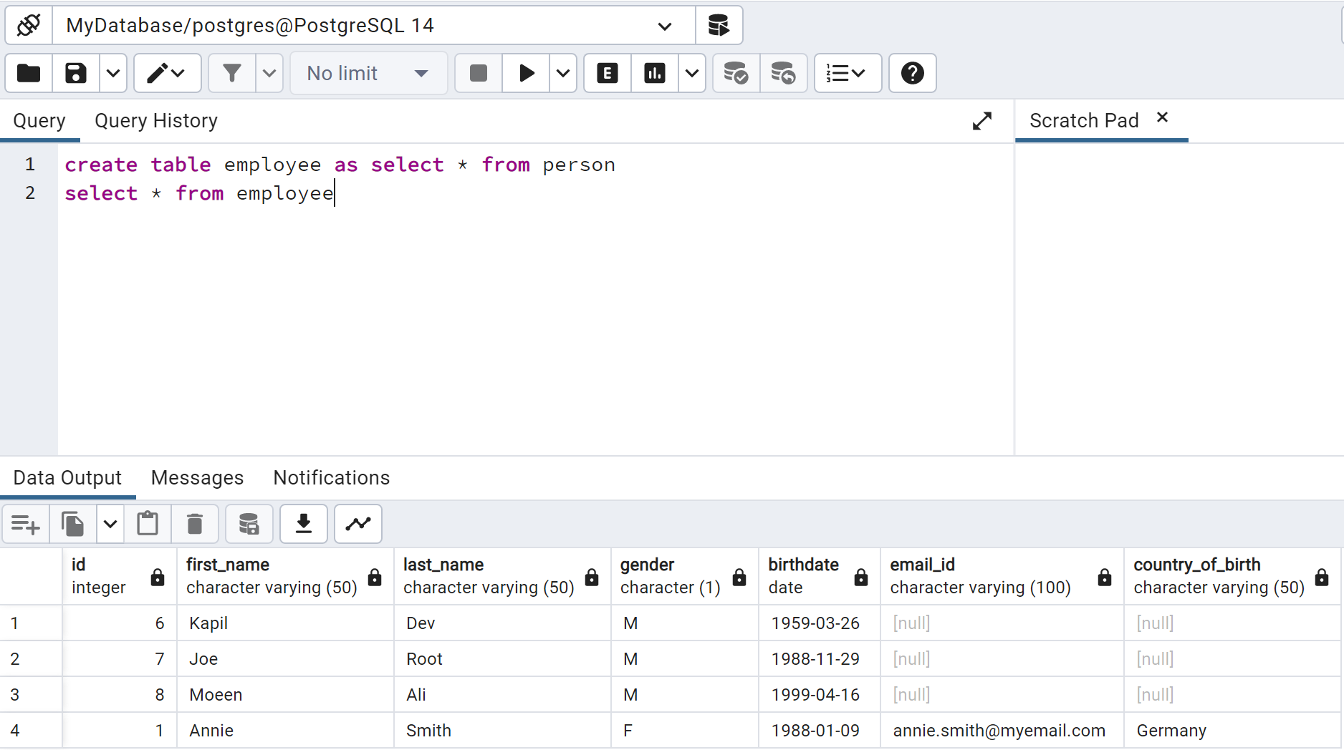
CREATE TABLE COMMAND (Cont..)
Create table as command: Use this statement to create a new table with data from the specified SELECT query.
CREATE TABLE [IF NOT EXISTS] <table_name> [(<column1>, <column2>, ...)] AS <Query>;
The following command will create the Employee table with the same column names and data types as SELECT query that selects data from the person table.
CREATE TABLE employee AS SELECT * FROM person;

Slide 36
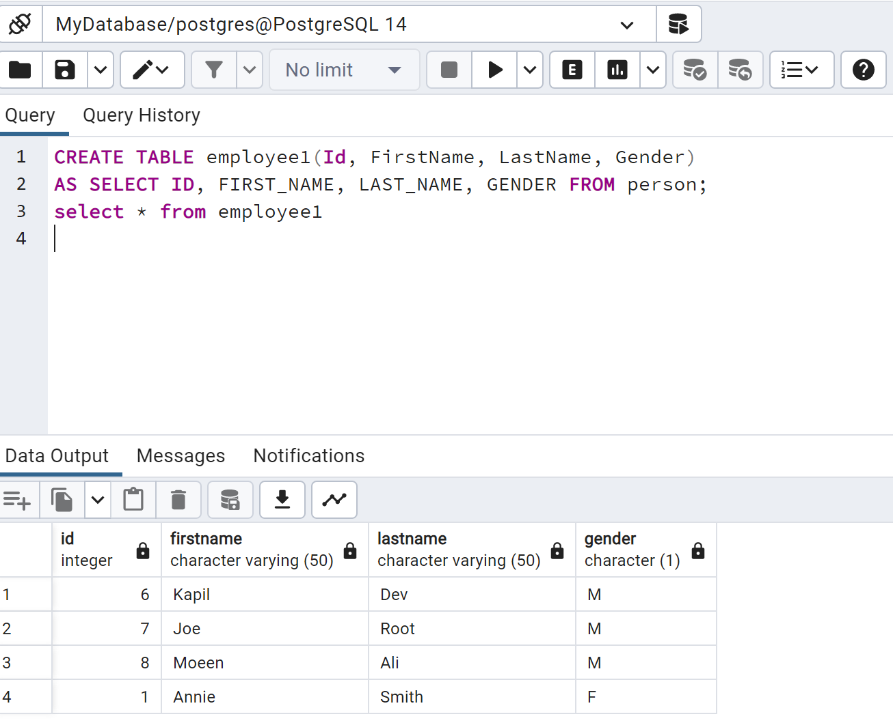
CREATE TABLE COMMAND (Cont..)
If you want to create a table with a selected column list then, you can select only required columns in the SELECT clause.
CREATE TABLE employee AS SELECT ID, FIRST_NAME, LAST_NAME FROM person;
If you want column names to be different from SELECT query columns you can specify new columns list.
CREATE TABLE employee1(Id, FirstName, LastName, Gender) AS SELECT ID, FIRST_NAME, LAST_NAME, GENDER FROM person;

Slide 37
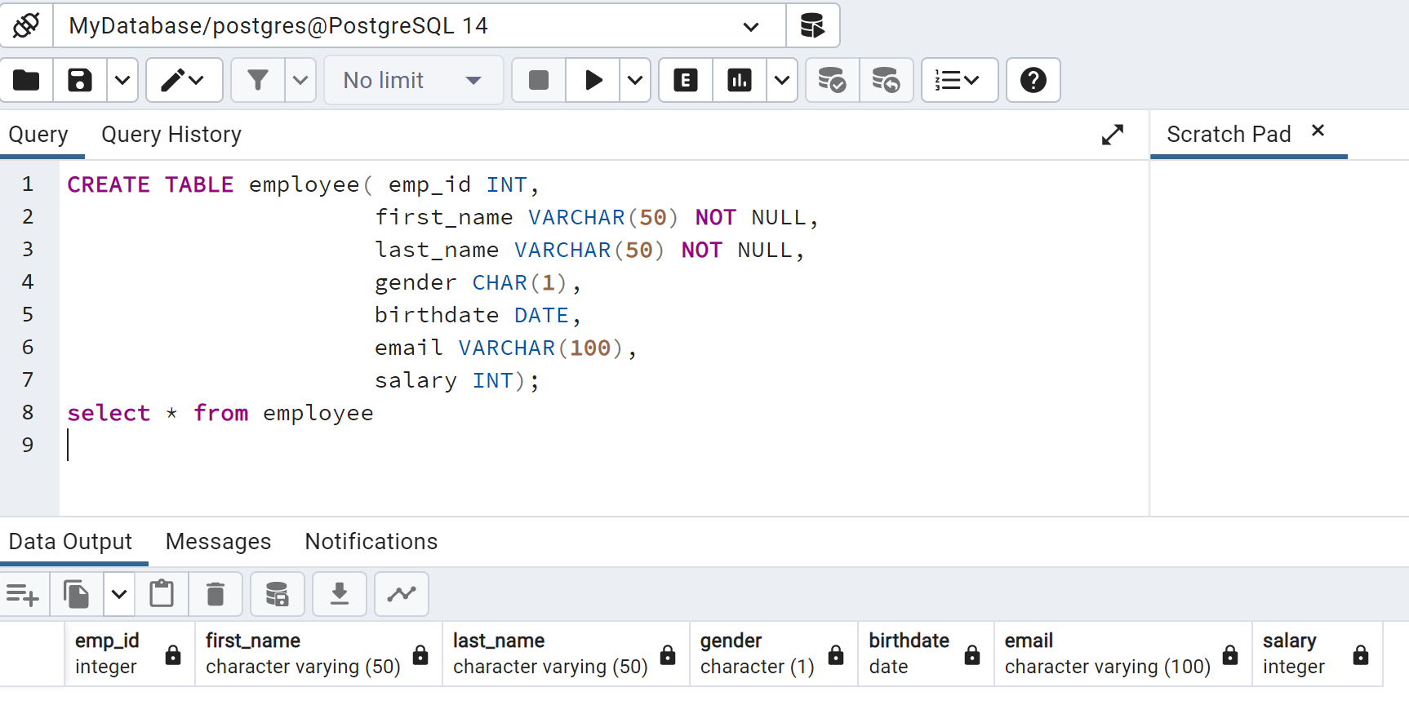
CREATE TABLE COMMAND (Cont..)
Define NOT NULL Constraint while Creating a Table: The following command declares NOT NULL columns in the CREATE TABLE statement. It will create the employee table with NOT NULL constraints on the first_name and last_name columns. If a column has a NOT NULL constraint defined on it then any attempt to insert or update the NULL value to that column will not be allowed and will raise an error.
CREATE TABLE employee( emp_id INT, first_name VARCHAR(50) NOT NULL, last_name VARCHAR(50) NOT NULL, gender CHAR(1), birthdate DATE, email VARCHAR(100), salary INT);

Slide 38
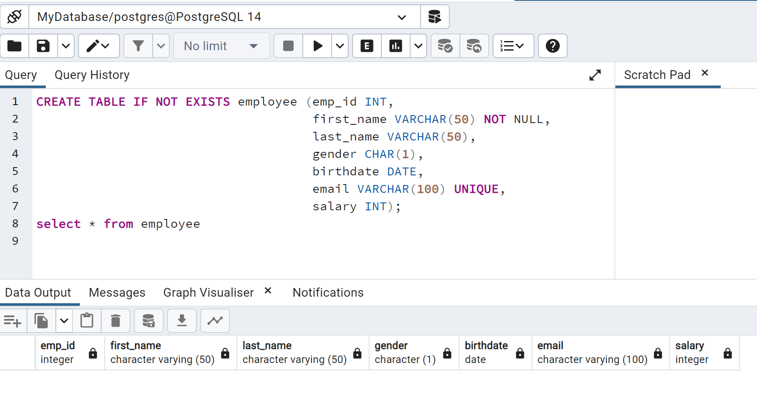
CREATE TABLE COMMAND (Cont..)
Define UNIQUE Constraint while Creating a Table: Unique constraints can be defined at the table level or at the column level, as shown below. The following command creates a unique constraint on the email column of the employee table.
CREATE TABLE IF NOT EXISTS employee (emp_id INT, first_name VARCHAR(50) NOT NULL, last_name VARCHAR(50), gender CHAR(1), birthdate DATE, email VARCHAR(100) UNIQUE, salary INT);
38

Slide 39
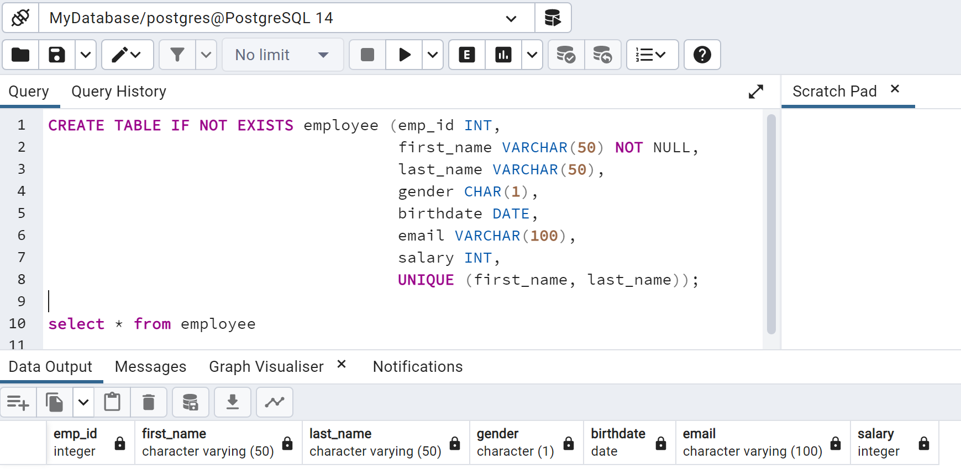
CREATE TABLE COMMAND (Cont..)
When a unique constraint is defined on a group of columns, then the combination of those column values needs to be unique across the table. A Unique constraint can be defined on multiple columns by specifying it at table level.
CREATE TABLE IF NOT EXISTS employee (emp_id INT, first_name VARCHAR(50) NOT NULL, last_name VARCHAR(50), gender CHAR(1), birthdate DATE, email VARCHAR(100), salary INT, UNIQUE (first_name, last_name));

Slide 40
CREATE TABLE COMMAND (Cont..)
Define PRIMARY KEY Constraint while Creating a Table: you can define a primary key on a single column by writing "primary key" after the column name in the CREATE TABLE statement. For example, the following CREATE TABLE statement will create the employee table with a primary key defined on emp_id column. This is called defining a primary key at the column level.
CREATE TABLE IF NOT EXISTS employee (emp_id INT PRIMARY KEY, first_name VARCHAR(50), last_name VARCHAR(50), gender CHAR(1), birthdate DATE, email VARCHAR (100), salary INT);
The Primary key can be defined on more than one column also. For example, the following command defines a primary key on two columns:
CREATE TABLE IF NOT EXISTS employee_department (emp_id INT, dept_id INT, CONSTRAINT empid_deptid_pkey PRIMARY KEY (emp_id, dept_id));

Slide 41
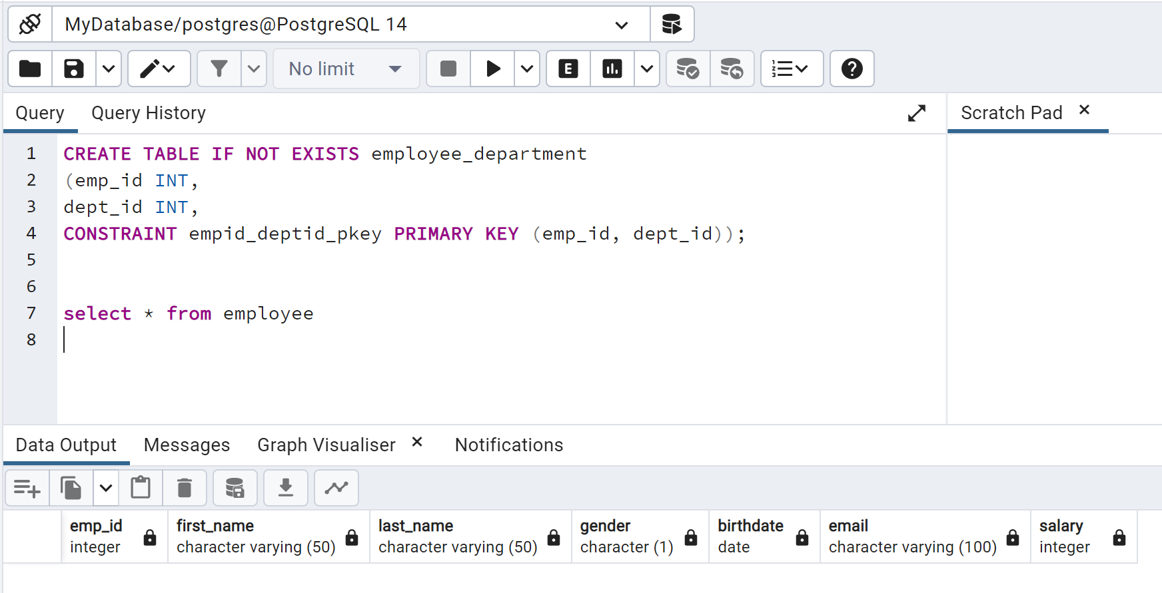
CREATE TABLE COMMAND (Cont..)

Slide 42
CREATE TABLE COMMAND (Cont..)
Define FOREIGN KEY Constraint while Creating a Table: The foreign key is a column(s) in a table that points to a primary key or unique key column in the same or another table. You can define a foreign key when you create a table using CREATE TABLE statement. The following example demonstrates creating a foreign key in the employee table that points to the department table.
CREATE TABLE department( dept_id INT PRIMARY KEY, dept_name VARCHAR(50) );
CREATE TABLE employee( emp_id INT PRIMARY KEY, first_name VARCHAR(50), last_name VARCHAR(50), email VARCHAR (100), hiredate DATE, manager_id INT, salary INT, dept_id INT,
CONSTRAINT FK_employee_department FOREIGN KEY(dept_id) REFERENCES department(dept_id) );

Slide 43
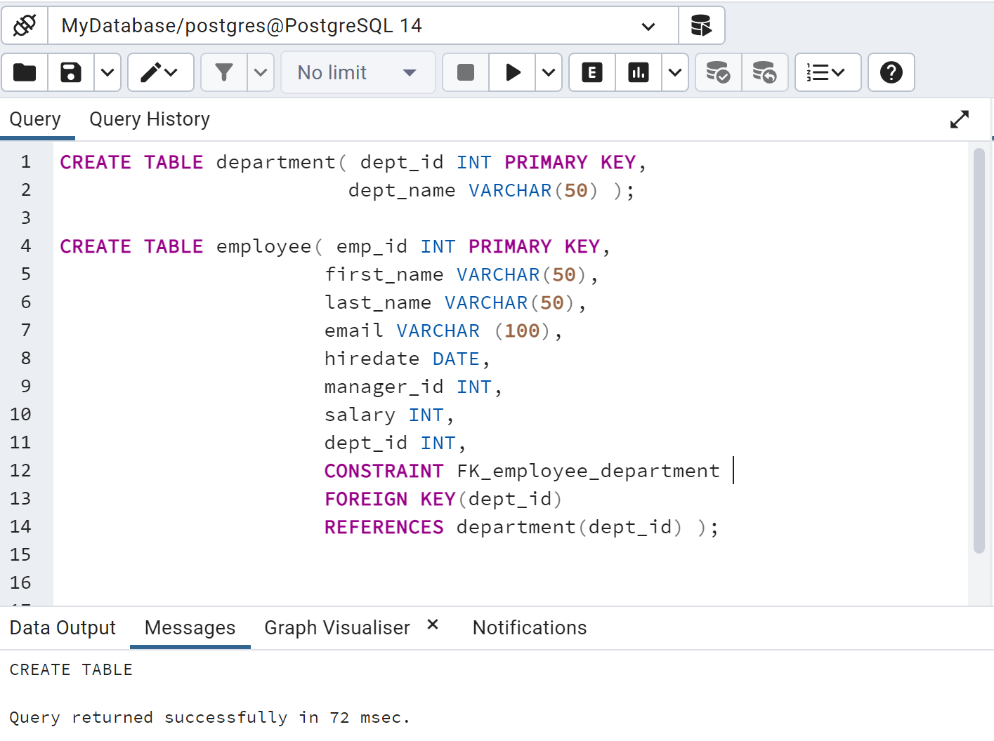
CREATE TABLE COMMAND (Cont..)

Slide 44
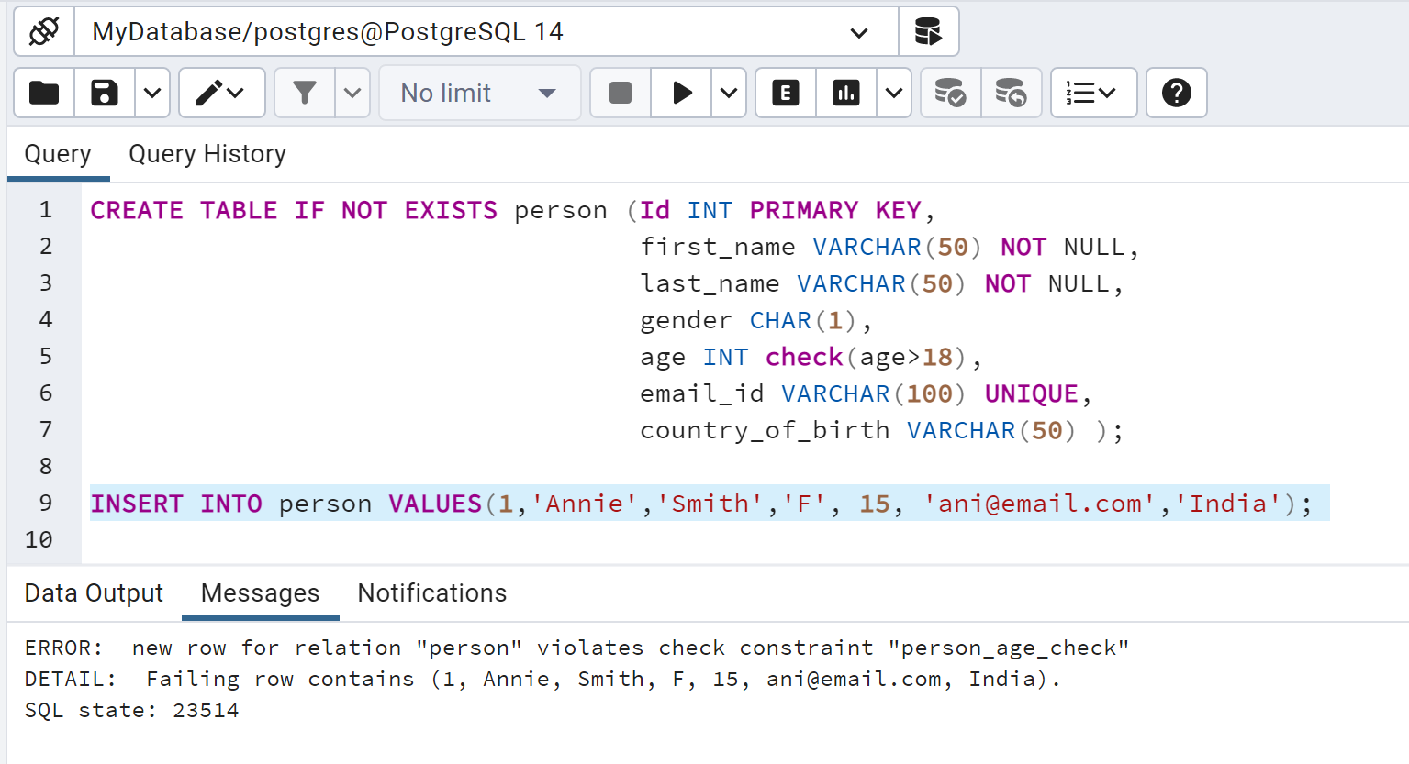
CREATE TABLE COMMAND (Cont..)
Define CHECK Constraint while Creating a Table: The CHECK constraint is used to limit the value range that can be placed in a column. The following SQL creates a CHECK constraint on the age column when the "Person" table is created. The CHECK constraint ensures that the age of a person must be grater than 18:

Slide 45
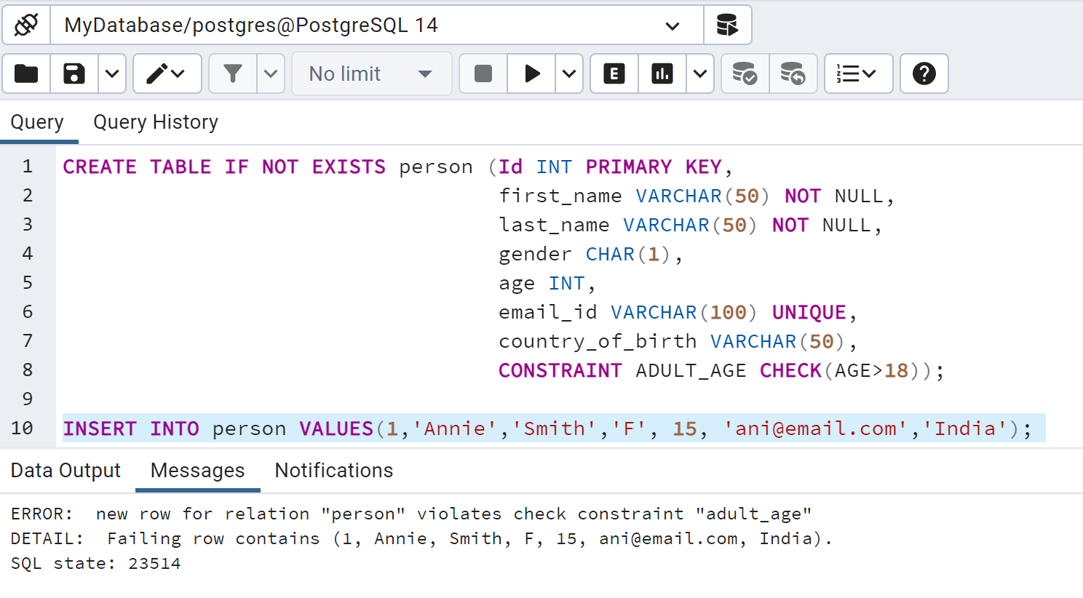
CREATE TABLE COMMAND (Cont..)
You can also give the constraint a separate name. This clarifies error messages and allows you to refer to the constraint when you need to change it. For example:

Slide 46
IMPORTANT FACTS RELATED TO THE SESSION
Structured Query Language(SQL) is the widely used database language for almost all types of relational databases, by the use of which we can perform certain operations on the existing database and also we can use this language to create a new database.
Data Definition Language can be used to define the database structure or schema.
Data Manipulation language can be used to access, store, modify, update and delete the existing records from the database.

Slide 47
SUMMARY
In this section, we discussed the various types of SQL languages and commands of these languages that are used to work on the database nd the data stored in the databases.
We also discussed the CREATE TABLE command in detail with its syntax and examples for creating the tables.

Slide 48
SELF-ASSESSMENT QUESTIONS
1. Commands that comes under DDL is/are –
CREATE
DROP
TRUCATE
ALLOF THE ABOVE
Command that comes under DML is/are –
ROLLBACK
GRANT
UPDATE
ALL OF THE ABOVE

Slide 49
SELF-ASSESSMENT QUESTIONS
3. Command that comes under DCL is/are -
GRANT
REVOKE
BOTH (a) AND (b)
NONE OF THE ABOVE
4. Following the completion of a transaction, it must be executed to save all the operations performed in the transaction. Here we are talking about which command?
REVOKE
COMMIT
ROLLBACK
SAVE

Slide 50
TERMINAL QUESTIONS
1. Describe various types of SQL Languages.
2. List out the commands of Data Definition Language with examples.
3. Analyze the DDL commands in PostgreSQL.
4. Summarize the create table command with its syntax and examples.

Slide 51
REFERENCES FOR FURTHER LEARNING OF THE SESSION
Reference Books:
1. Database System Concepts, Sixth Edition, Abraham Silberschatz, Yale University Henry, F. Korth Lehigh University, S. Sudarshan Indian Institute of Technology, Bombay.
2. An Introduction to Database Systems by Bipin C. Desai
3. Fundamentals of Database Systems, 7th Edition, RamezElmasri, University of Texas at Arlington, Shamkant B. Navathe, University of Texasat Arlington.
Sites and Web links:
1. https://www.geeksforgeeks.org/postgresql-create-table/
2. https://www.tutorialsteacher.com/postgresql

Slide 52
THANK YOU
Team – DBMS

